Slide 1

WEEK 6
PHP Basics I Level 4 Introduction to Internet Software Architecture

Slide 2
Week 6 Lecture Topic
Introduction to PHP
PHP Variables
PHP Data Types
PHP Conditions / Loops
PHP Arrays
PHP Functions

Slide 3

Introduction to PHP
1. Introduction to PHP
2. PHP Variables
3. PHP Data Types
4. PHP Conditions/Loop
5. PHP Arrays
6. PHP Functions
2. Learn more
The PHP Hypertext Preprocessor (PHP) is a programming language that allows web developers to create dynamic content that interacts with databases.
PHP is basically used for developing web based software applications.
PHP is a server scripting language, and a powerful tool for making dynamic and interactive Web pages.
PHP is a widely-used, free, and efficient

Slide 4
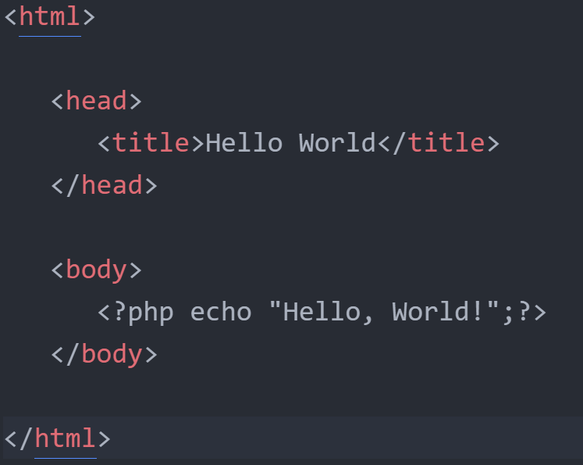
Introduction to PHP
1. Introduction to PHP
2. PHP Variables
3. PHP Data Types
4. PHP Conditions/Loop
5. PHP Arrays
6. PHP Functions
2. Learn more
Hello World Using PHP

Slide 5
Introduction to PHP
1. Introduction to PHP
2. PHP Variables
3. PHP Data Types
4. PHP Conditions/Loop
5. PHP Arrays
6. PHP Functions
2. Learn more
PHP performs system functions, i.e. from files on a system it can create, open, read, write, and close them.
PHP can handle forms, i.e. gather data from files, save data to a file, through email you can send data, return data to the user.
You add, delete, modify elements within your database through PHP.
Access cookies variables and set cookies.
Using PHP, you can restrict users to access some pages of your website.
It can encrypt data.

Slide 6
Introduction to PHP
1. Introduction to PHP
2. PHP Variables
3. PHP Data Types
4. PHP Conditions/Loop
5. PHP Arrays
6. PHP Functions
2. Learn more
All PHP code must be included inside one of the three special markup tags.
It is then recognised by the PHP Parser.
<?php PHP code goes here ?>
<? PHP code goes here ?>
<script language = "php"> PHP code goes here </script>
A most common tag is the <?php...?> and we will also use the same tag in our tutorial.

Slide 7
PHP Variables
1. Introduction to PHP
2. PHP Variables
3. PHP Data Types
4. PHP Conditions/Loop
5. PHP Arrays
6. PHP Functions
2. Learn more
A variable can have a short name (like x and y) or a more descriptive name (age, carname, total_volume).
Rules for PHP variables:
A variable starts with the $ sign, followed by the name of the variable
A variable name must start with a letter or the underscore character
A variable name cannot start with a number
A variable name can only contain alphanumeric characters and underscores (A-z, 0-9, and _ )
Variable names are case-sensitive ($age and $AGE are two different variables)

Slide 8
PHP Variables
1. Introduction to PHP
2. PHP Variables
3. PHP Data Types
4. PHP Conditions/Loop
5. PHP Arrays
6. PHP Functions
2. Learn more
In PHP, a variable starts with the $ sign, followed by the name of the variable:
Example
<?php
$txt = "Hello world!";
$x = 5;
$y = 10.5;
?>

Slide 9
PHP Data Types
1. Introduction to PHP
2. PHP Variables
3. PHP Data Types
4. PHP Conditions/Loop
5. PHP Arrays
6. PHP Functions
2. Learn more
PHP has a total of eight data types which we use to construct our variables −
Integers − are whole numbers, without a decimal point, like 4195.
Doubles − are floating-point numbers, like 3.14159 or 49.1.
Booleans − have only two possible values either true or false.
NULL − is a special type that only has one value: NULL.

Slide 10
PHP Data Types
1. Introduction to PHP
2. PHP Variables
3. PHP Data Types
4. PHP Conditions/Loop
5. PHP Arrays
6. PHP Functions
2. Learn more
Strings − are sequences of characters, like 'PHP supports string operations.'
Arrays − are named and indexed collections of other values.
Objects − are instances of programmer-defined classes, which can package up both other kinds of values and functions that are specific to the class.
Resources − are special variables that hold references to resources external to PHP (such as database connections).

Slide 11
PHP Conditions/Loop
1. Introduction to PHP
2. PHP Variables
3. PHP Data Types
4. PHP Conditions/Loop
5. PHP Arrays
6. PHP Functions
2. Learn more
The if, elseif ...else and switch statements are used to take decision based on the different condition.
You can use conditional statements in your code to make your decisions. PHP supports following three decision making statements −
if...else statement − use this statement if you want to execute a set of code when a condition is true and another if the condition is not true
elseif statement − is used with the if...else statement to execute a set of code if one of the several condition is true
switch statement − is used if you want to select one of many blocks of code to be executed, use the Switch statement. The switch statement is used to avoid long blocks of if..elseif..else code.

Slide 12
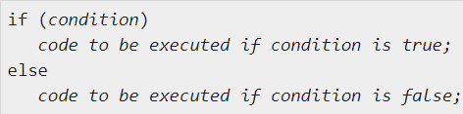
PHP Conditions/Loop
1. Introduction to PHP
2. PHP Variables
3. PHP Data Types
4. PHP Conditions/Loop
5. PHP Arrays
6. PHP Functions
2. Learn more
IF Else Condition
If you want to execute some code if a condition is true and another code if a condition is false, use the if....else statement.
Syntax

Slide 13
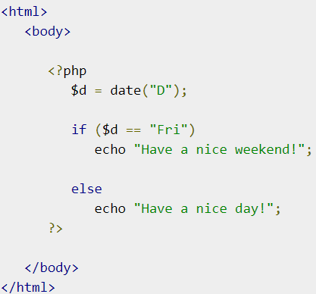
PHP Conditions/Loop
1. Introduction to PHP
2. PHP Variables
3. PHP Data Types
4. PHP Conditions/Loop
5. PHP Arrays
6. PHP Functions
2. Learn more
Example

Slide 14
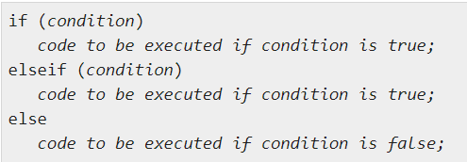
PHP Conditions/Loop
1. Introduction to PHP
2. PHP Variables
3. PHP Data Types
4. PHP Conditions/Loop
5. PHP Arrays
6. PHP Functions
2. Learn more
If ElseIf Condition
If you want to execute some code if one of the several conditions are true use the elseif statement
Syntax

Slide 15
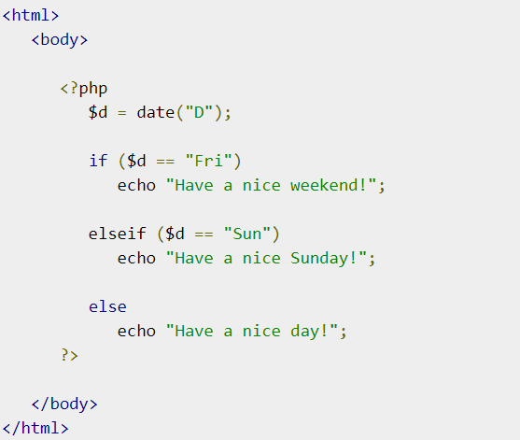
PHP Conditions/Loop
1. Introduction to PHP
2. PHP Variables
3. PHP Data Types
4. PHP Conditions/Loop
5. PHP Arrays
6. PHP Functions
2. Learn more
Example

Slide 16
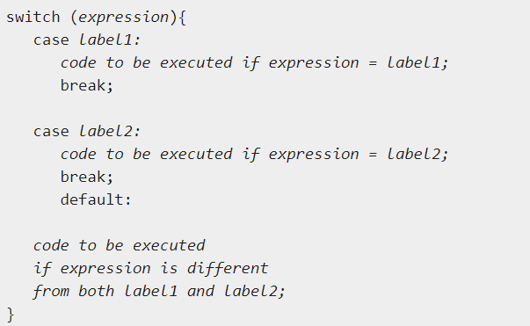
PHP Conditions/Loop
1. Introduction to PHP
2. PHP Variables
3. PHP Data Types
4. PHP Conditions/Loop
5. PHP Arrays
6. PHP Functions
2. Learn more
The Switch Condition
If you want to select one of many blocks of code to be executed, use the Switch statement.
The switch statement is used to avoid long blocks of if..elseif..else code.
Syntax

Slide 17
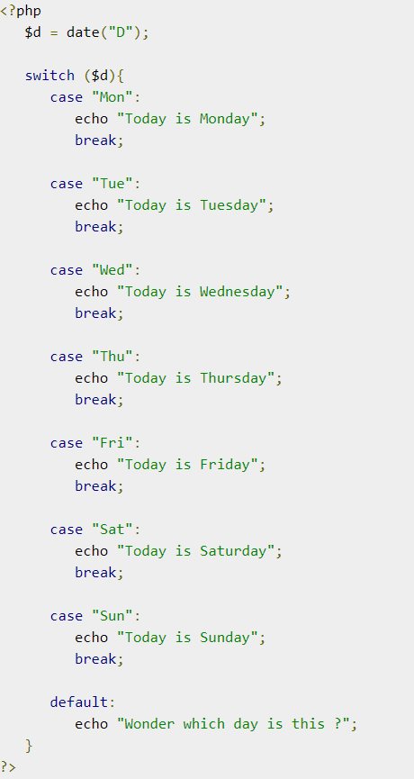
PHP Conditions/Loop
1. Introduction to PHP
2. PHP Variables
3. PHP Data Types
4. PHP Conditions/Loop
5. PHP Arrays
6. PHP Functions
2. Learn more
Example

Slide 18
PHP Conditions/Loop
1. Introduction to PHP
2. PHP Variables
3. PHP Data Types
4. PHP Conditions/Loop
5. PHP Arrays
6. PHP Functions
2. Learn more
Loops in PHP are used to execute the same block of code a specified number of times. PHP supports following four loop types.
for − loops through a block of code a specified number of times.
while − loops through a block of code if and as long as a specified condition is true.
do...while − loops through a block of code once, and then repeats the loop as long as a special condition is true.
foreach − loops through a block of code for each element in an array.

Slide 19

PHP Conditions/Loop
1. Introduction to PHP
2. PHP Variables
3. PHP Data Types
4. PHP Conditions/Loop
5. PHP Arrays
6. PHP Functions
2. Learn more
For Loop
The for statement is used when you know how many times you want to execute a statement or a block of statements.
Syntax

Slide 20
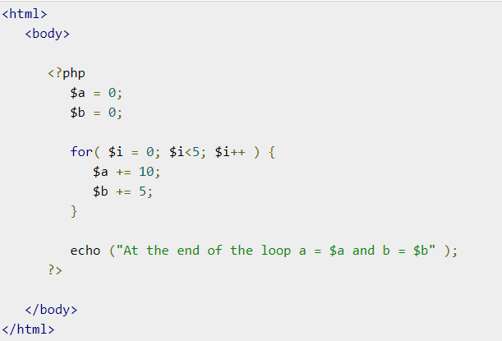
PHP Conditions/Loop
1. Introduction to PHP
2. PHP Variables
3. PHP Data Types
4. PHP Conditions/Loop
5. PHP Arrays
6. PHP Functions
2. Learn more
Example:

Slide 21

PHP Conditions/Loop
1. Introduction to PHP
2. PHP Variables
3. PHP Data Types
4. PHP Conditions/Loop
5. PHP Arrays
6. PHP Functions
2. Learn more
The While Loop:
The while statement will execute a block of code if and as long as a test expression is true.
If the test expression is true then the code block will be executed. After the code has executed the test expression will again be evaluated and the loop will continue until the test expression is found to be false.
Syntax

Slide 22
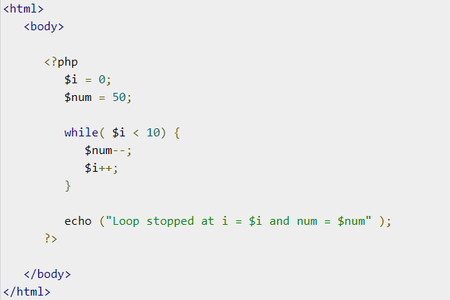
PHP Conditions/Loop
1. Introduction to PHP
2. PHP Variables
3. PHP Data Types
4. PHP Conditions/Loop
5. PHP Arrays
6. PHP Functions
2. Learn more

Slide 23
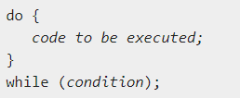
PHP Conditions/Loop
1. Introduction to PHP
2. PHP Variables
3. PHP Data Types
4. PHP Conditions/Loop
5. PHP Arrays
6. PHP Functions
2. Learn more
Do While Loop
The do...while statement will execute a block of code at least once - it then will repeat the loop as long as a condition is true.
Syntax

Slide 24
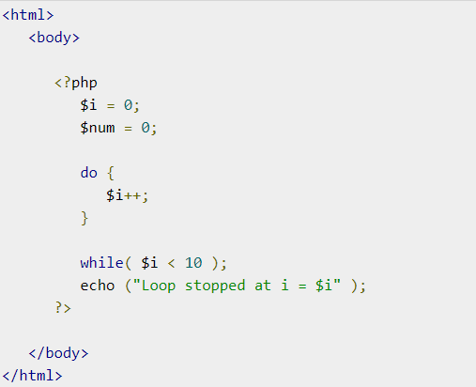
PHP Conditions/Loop
1. Introduction to PHP
2. PHP Variables
3. PHP Data Types
4. PHP Conditions/Loop
5. PHP Arrays
6. PHP Functions
2. Learn more

Slide 25

PHP Conditions/Loop
1. Introduction to PHP
2. PHP Variables
3. PHP Data Types
4. PHP Conditions/Loop
5. PHP Arrays
6. PHP Functions
2. Learn more
The foreach statement is used to loop through arrays. For each pass the value of the current array element is assigned to $value and the array pointer is moved by one and in the next pass next element will be processed.
Syntax

Slide 26
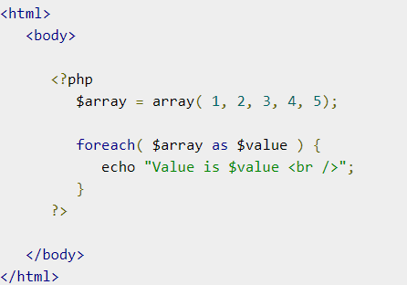
PHP Conditions/Loop
1. Introduction to PHP
2. PHP Variables
3. PHP Data Types
4. PHP Conditions/Loop
5. PHP Arrays
6. PHP Functions
2. Learn more

Slide 27
PHP Arrays
1. Introduction to PHP
2. PHP Variables
3. PHP Data Types
4. PHP Conditions/Loop
5. PHP Arrays
6. PHP Functions
2. Learn more
An array is a data structure that stores one or more similar type of values in a single value. For example if you want to store 100 numbers then instead of defining 100 variables it's easy to define an array of 100 length.
There are three different kind of arrays and each array value is accessed using an ID which is called array index.
Numeric array − An array with a numeric index. Values are stored and accessed in linear fashion.
Associative array − An array with strings as index. This stores element values in association with key values rather than in a strict linear index order.
Multidimensional array − An array containing one or more arrays and values are accessed using multiple indices

Slide 28
PHP Arrays
1. Introduction to PHP
2. PHP Variables
3. PHP Data Types
4. PHP Conditions/Loop
5. PHP Arrays
6. PHP Functions
2. Learn more
Numeric Array
These arrays can store numbers, strings and any object but their index will be represented by numbers. By default array index starts from zero.
Example
Following is the example showing how to create and access numeric arrays.
Here we have used array() function to create array. This function is explained in function reference.

Slide 29
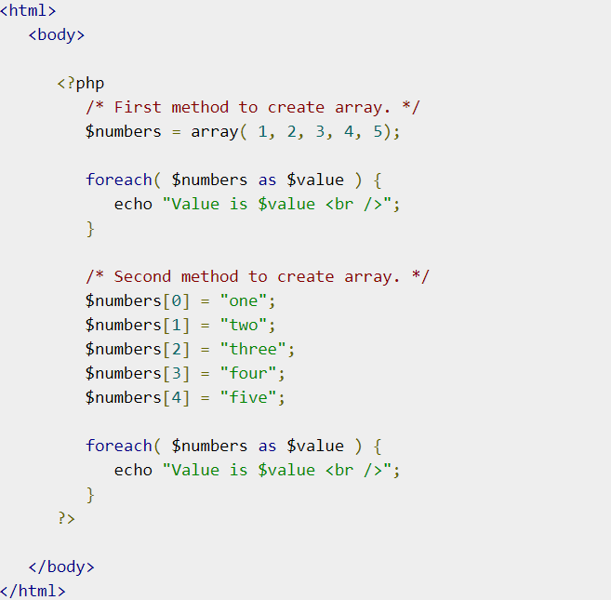
PHP Arrays
1. Introduction to PHP
2. PHP Variables
3. PHP Data Types
4. PHP Conditions/Loop
5. PHP Arrays
6. PHP Functions
2. Learn more

Slide 30
PHP Arrays
1. Introduction to PHP
2. PHP Variables
3. PHP Data Types
4. PHP Conditions/Loop
5. PHP Arrays
6. PHP Functions
2. Learn more
Associative Array
The associative arrays are very similar to numeric arrays in term of functionality but they are different in terms of their index.
Associative array will have their index as string so that you can establish a strong association between key and values.
Example:
To store the salaries of employees in an array, a numerically indexed array would not be the best choice. Instead, we could use the employees names as the keys in our associative array, and the value would be their respective salary.

Slide 31
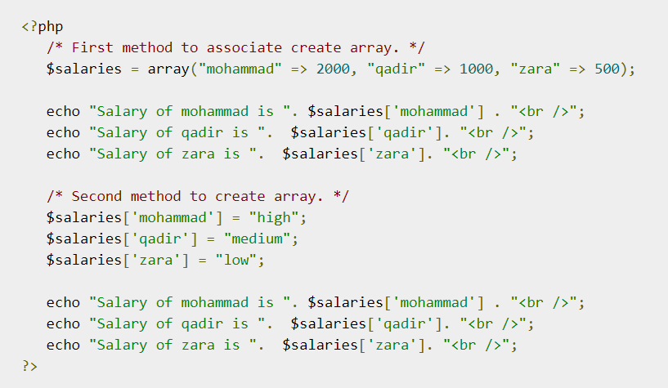
PHP Arrays
1. Introduction to PHP
2. PHP Variables
3. PHP Data Types
4. PHP Conditions/Loop
5. PHP Arrays
6. PHP Functions
2. Learn more

Slide 32
PHP Arrays
1. Introduction to PHP
2. PHP Variables
3. PHP Data Types
4. PHP Conditions/Loop
5. PHP Arrays
6. PHP Functions
2. Learn more
Multidimensional Array
A multidimensional array each element in the main array can also be an array. And each element in the sub-array can be an array, and so on. Values in the multi-dimensional array are accessed using multiple index.
Example
In this example we create a two dimensional array to store marks of three students in three subjects −
This example is an associative array, you can create numeric array in the same fashion.

Slide 33
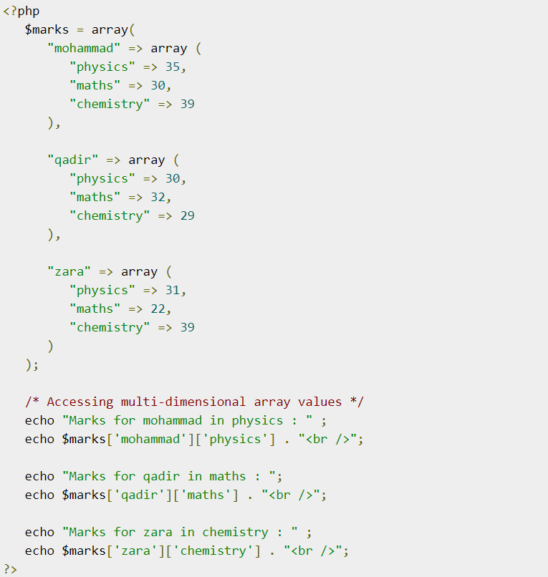
PHP Arrays
1. Introduction to PHP
2. PHP Variables
3. PHP Data Types
4. PHP Conditions/Loop
5. PHP Arrays
6. PHP Functions
2. Learn more

Slide 34
PHP Functions
1. Introduction to PHP
2. PHP Variables
3. PHP Data Types
4. PHP Conditions/Loop
5. PHP Arrays
6. PHP Functions
2. Learn more
PHP functions are similar to other programming languages.
A function is a piece of code which takes one more input in the form of parameter and does some processing and returns a value.
There are two parts which should be clear to you −
Creating a PHP Function
Calling a PHP Function
In fact you hardly need to create your own PHP function because there are already more than 1000 of built-in library functions created for different area and you just need to call them according to your requirement.

Slide 35
PHP Functions
1. Introduction to PHP
2. PHP Variables
3. PHP Data Types
4. PHP Conditions/Loop
5. PHP Arrays
6. PHP Functions
2. Learn more
Its very easy to create your own PHP function.
Suppose you want to create a PHP function which will simply write a simple message on your browser when you will call it. Following example creates a function called writeMessage() and then calls it just after creating it.
Note that while creating a function its name should start with keyword function and all the PHP code should be put inside { and } braces as shown in the following example below −

Slide 36
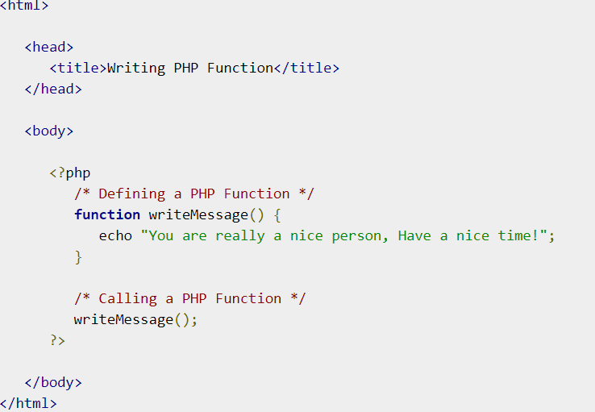
PHP Functions
1. Introduction to PHP
2. PHP Variables
3. PHP Data Types
4. PHP Conditions/Loop
5. PHP Arrays
6. PHP Functions
2. Learn more

Slide 37
Learn More
1. Introduction to PHP
2. PHP Variables
3. PHP Data Types
4. PHP Conditions/Loop
5. PHP Arrays
6. PHP Functions
2. Learn more
PHP Tutorial (w3schools.com)
Learn PHP Tutorial - javatpoint
PHP Tutorial - Tutorialspoint
PHP: A simple tutorial - Manual
The Modern PHP Tutorial

